Slide 1


Search Engine Presentation
By Leaves

Slide 2

01
Introduction of the Function

Slide 3
01
Introduction of the Function
This is a simple Search Engine for RUC Information School.
Like google,you can submit your query words into this system,then you will get the search answers for the query in RUCINFO.
Search results are available until July 12.
Enjoy yourself.
文艺让生活更有范，文艺让生活更有范，文艺文艺让生活更有范文艺让生活更有范。文艺让生活更有范，文艺让生活更有范。

Slide 4
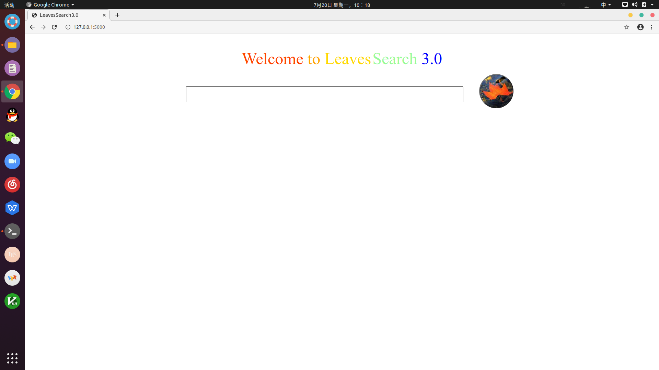
01
Introduction of the Function
文艺让生活更有范，文艺让生活更有范，文艺文艺让生活更有范文艺让生活更有范。文艺让生活更有范，文艺让生活更有范。

Slide 5
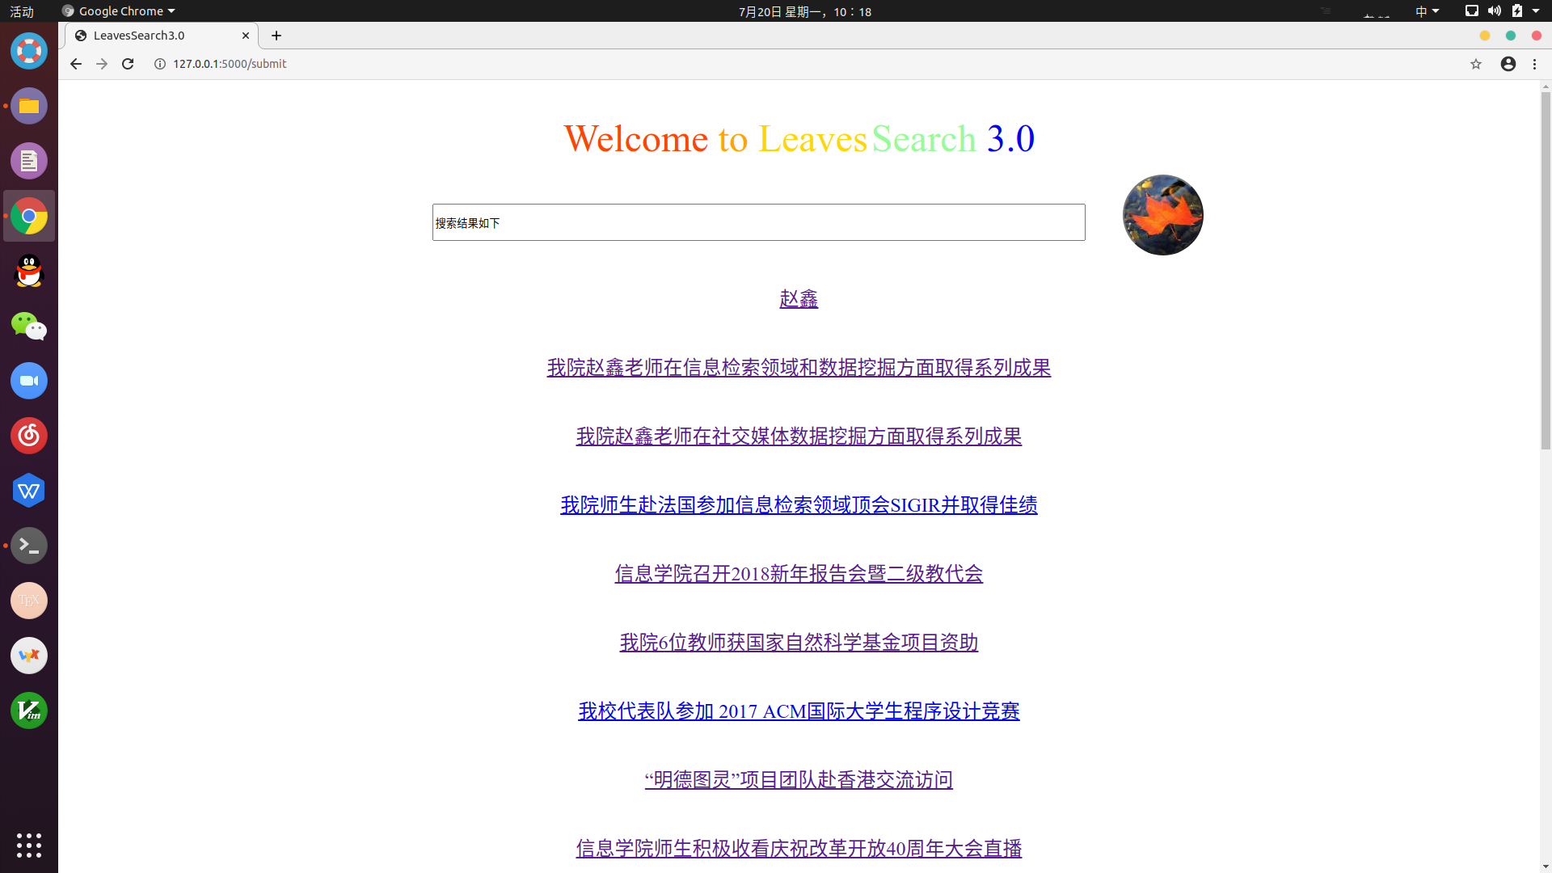
01
Introduction of the Function
文艺让生活更有范，文艺让生活更有范，文艺文艺让生活更有范文艺让生活更有范。文艺让生活更有范，文艺让生活更有范。

Slide 6
02
设计思路

Slide 7
02
设计思路
No.1 How to get the url?
The root of url is http://info.ruc.edu.cn/.
We start with this one,using “wget” to download the html test of this url.Then read every possible url in the html,and do normalizing,delete some illegal url like “.doc” “.pdf” “.xls” and so on.Push legal url into the Queue.And do the same thing to others.
文艺让生活更有范，文艺让生活更有范，文艺文艺让生活更有范文艺让生活更有范。文艺让生活更有范，文艺让生活更有范。

Slide 8
02
设计思路
No.2 How to get the words and cut them?
For each url,we read the title and tests in its html.Like <title> or <p>,we read the words after these label.
Use THULAC to cut words,and ignore some words’ characteristic like ‘w’ or ‘h’.
文艺让生活更有范，文艺让生活更有范，文艺文艺让生活更有范文艺让生活更有范。文艺让生活更有范，文艺让生活更有范。

Slide 9
02
设计思路
No.3 How to Search?
First,we cut the query words.
Then calculate the tf-idf for the query and each document.We have a vector for each document now.
Calculate the cos between the query’s vector and document’s.Choose the best,the biggest.
Sort them by cos.Take K url and give them to the query.
文艺让生活更有范，文艺让生活更有范，文艺文艺让生活更有范文艺让生活更有范。文艺让生活更有范，文艺让生活更有范。

Slide 10
02
设计思路
No.4 Language
We use C++ to write urlget,cut ,pre and Search
Use python to write appweb.(use flask)
Use html to write UI.
文艺让生活更有范，文艺让生活更有范，文艺文艺让生活更有范文艺让生活更有范。文艺让生活更有范，文艺让生活更有范。

Slide 11
03
编程技巧

Slide 12
03
编程技巧
No.1 How to get tf-idf?
We can’t wget every html and calculate tf-idf at the beginning of the Search.It costs too much time.We need to do preparation.
We write a file of tf for every document and write a file for word’s IDF.When we need them,we just read the file and get the informations.
文艺让生活更有范，文艺让生活更有范，文艺文艺让生活更有范文艺让生活更有范。文艺让生活更有范，文艺让生活更有范。

Slide 13
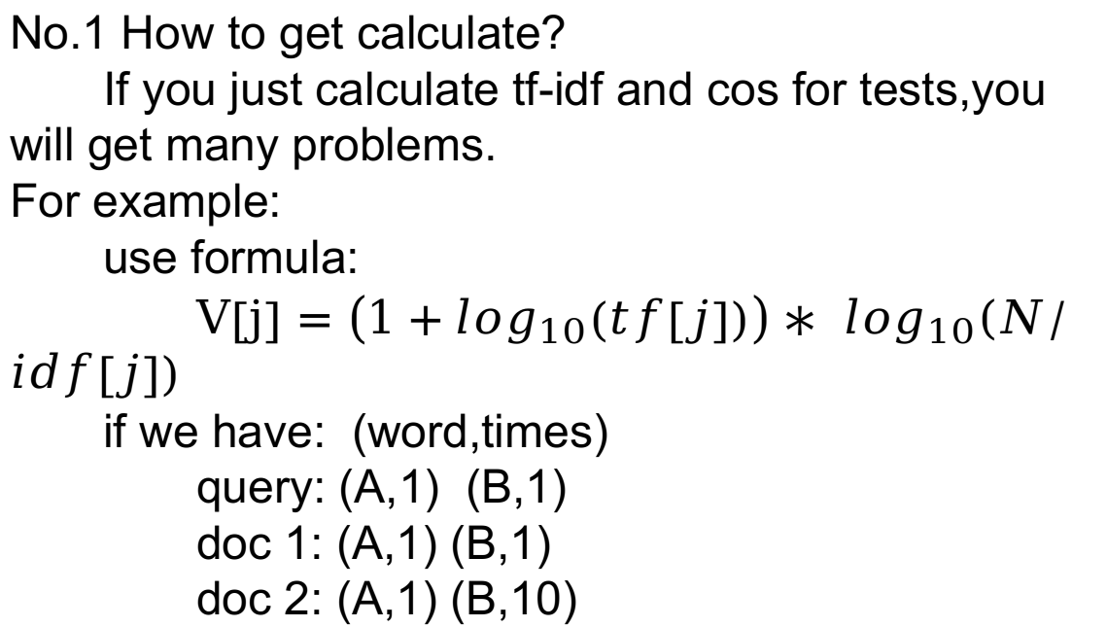
03
编程技巧
No.1 How to get calculate?
If you just calculate tf-idf and cos for tests,you will get many problems.
For example:
use formula:
$V\left[j\right]=\left(1+\log_{10}\left(tf\left[j\right]\right)\right)∗ \log_{10}\left(N/idf\left[j\right]\right)$
if we have: (word,times)
query: (A,1) (B,1)
doc 1: (A,1) (B,1)
doc 2: (A,1) (B,10)
文艺让生活更有范，文艺让生活更有范，文艺文艺让生活更有范文艺让生活更有范。文艺让生活更有范，文艺让生活更有范。

Slide 14
03
编程技巧
Although we know,B is more important than A(like A=‘人大’,B=‘ACM’),but IDF is same to every doc and query,so as to the cos,the answer will choose doc1 instead of doc2.
And one more things,when we are Searching,the title is often more important than the contents.So we need to take titles into consideration.
文艺让生活更有范，文艺让生活更有范，文艺文艺让生活更有范文艺让生活更有范。文艺让生活更有范，文艺让生活更有范。

Slide 15
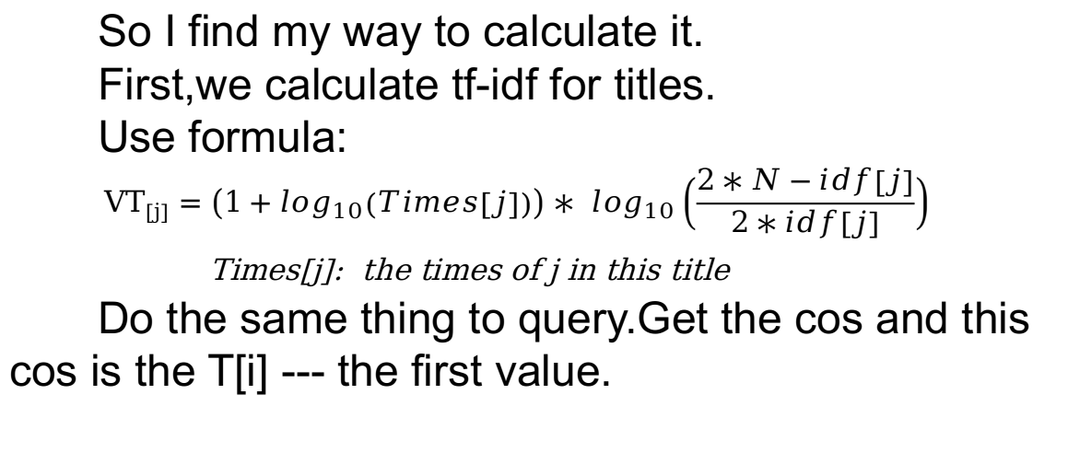
03
编程技巧
So I find my way to calculate it.
First,we calculate tf-idf for titles.
Use formula:
$${VT}_{\left[j\right]}=\left(1+\log_{10}\left(Times\left[j\right]\right)\right)∗ \log_{10}\left(\frac{2∗N−idf\left[j\right]}{2∗idf\left[j\right]}\right)$$
Times[j]: the times of j in this title
Do the same thing to query.Get the cos and this cos is the T[i] --- the first value.
文艺让生活更有范，文艺让生活更有范，文艺文艺让生活更有范文艺让生活更有范。文艺让生活更有范，文艺让生活更有范。

Slide 16
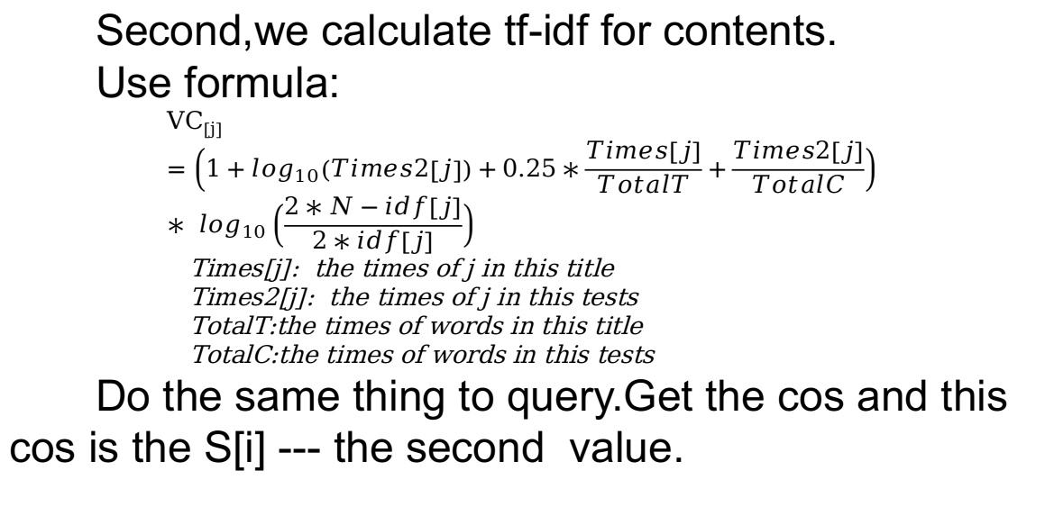
03
编程技巧
Second,we calculate tf-idf for contents.
Use formula:
$${VC}_{\left[j\right]}=\left(1+\log_{10}\left(Times2\left[j\right]\right)+0.25∗\frac{Times\left[j\right]}{TotalT}+\frac{Times2\left[j\right]}{TotalC}\right)∗ \log_{10}\left(\frac{2∗N−idf\left[j\right]}{2∗idf\left[j\right]}\right)$$
Times[j]: the times of j in this title
Times2[j]: the times of j in this tests
TotalT:the times of words in this title
TotalC:the times of words in this tests
Do the same thing to query.Get the cos and this cos is the S[i] --- the second value.
文艺让生活更有范，文艺让生活更有范，文艺文艺让生活更有范文艺让生活更有范。文艺让生活更有范，文艺让生活更有范。

Slide 17
03
编程技巧
Then sort url by first value.If first value is same,then sort by second value.
In this way,We can keep the importance of titles by first value.And when titels value is same,we can compare the test by second value.In second value,we use log10 , word frequency for title and tests.And use coefficient to decrease the effect from titles.（another way is add F&S value and sort)
And the answer is not so bad.
文艺让生活更有范，文艺让生活更有范，文艺文艺让生活更有范文艺让生活更有范。文艺让生活更有范，文艺让生活更有范。

Slide 18
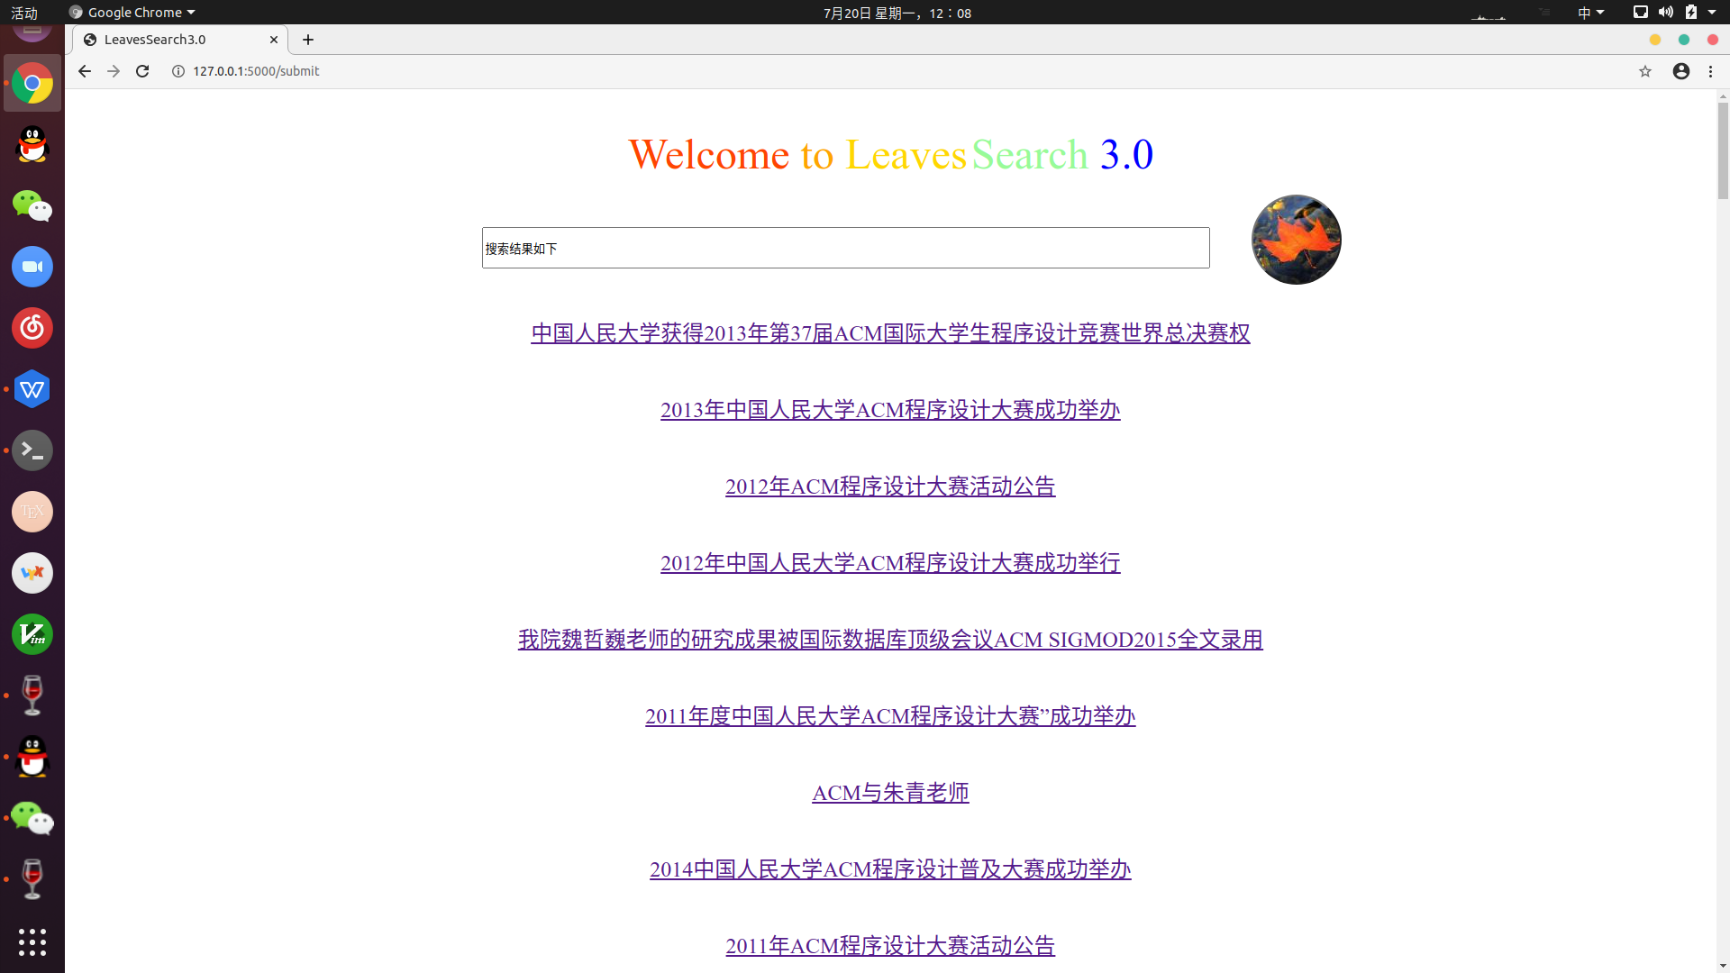
03
Answers for ACM 大赛
文艺让生活更有范，文艺让生活更有范，文艺文艺让生活更有范文艺让生活更有范。文艺让生活更有范，文艺让生活更有范。

Slide 19
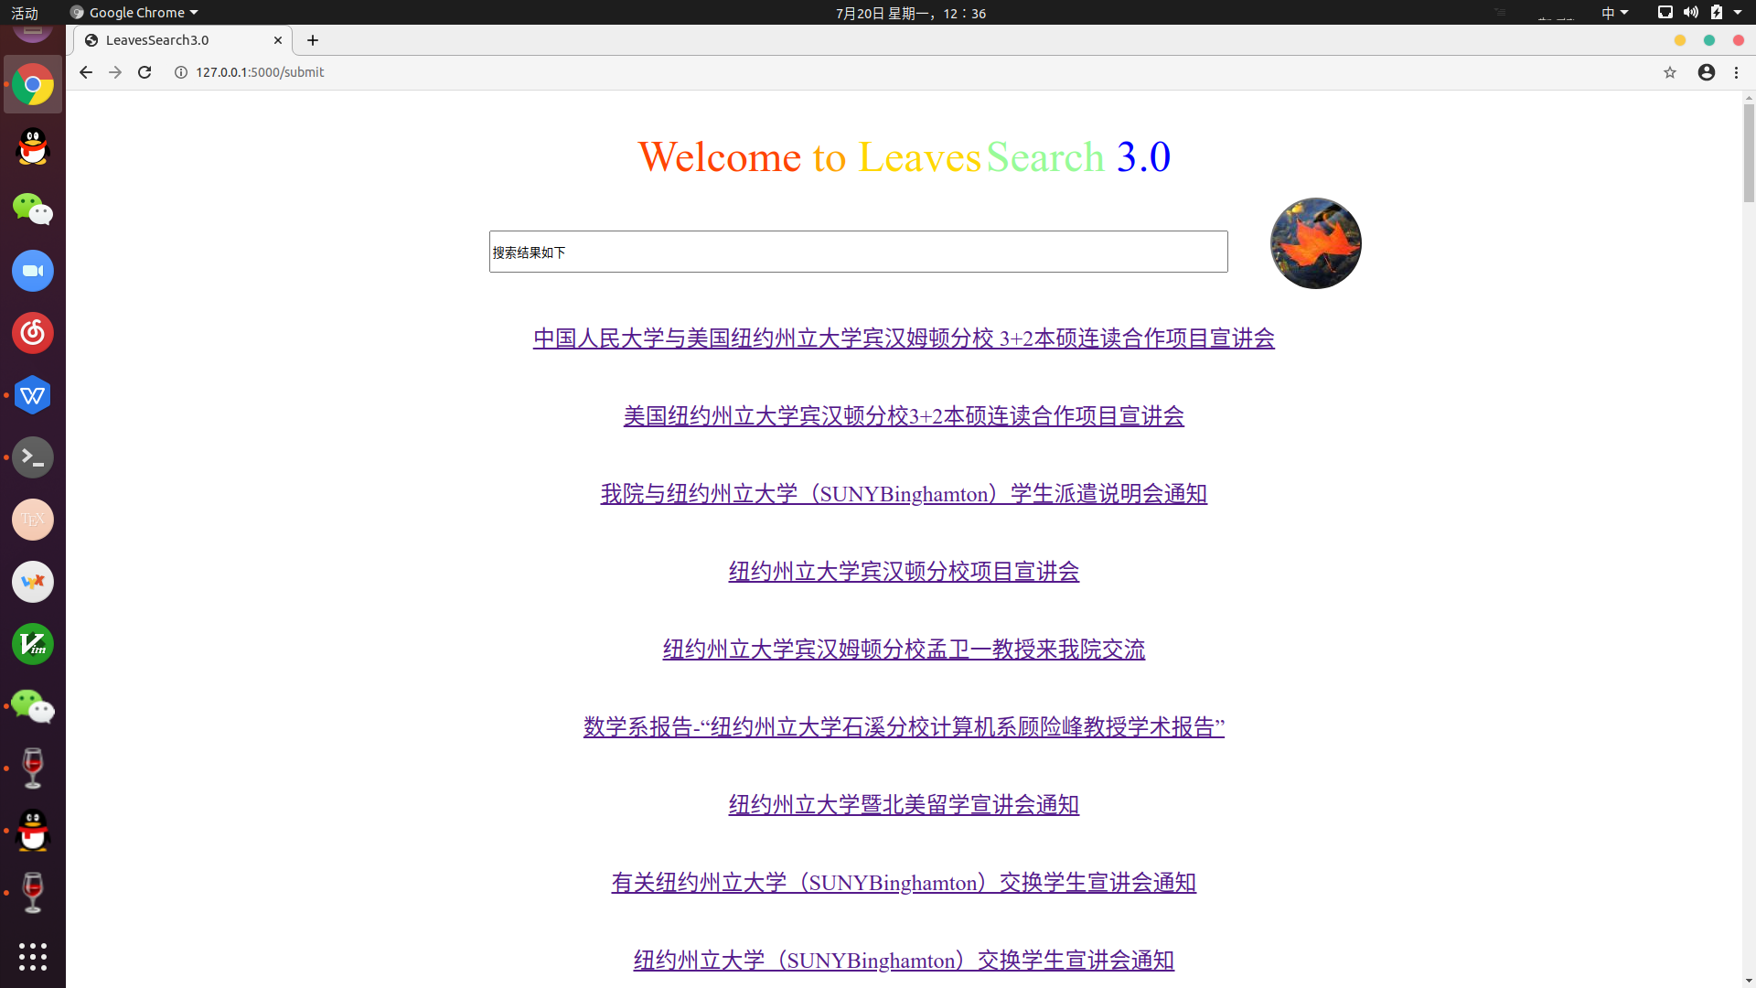
03
Answers for 纽约州立宣讲
文艺让生活更有范，文艺让生活更有范，文艺文艺让生活更有范文艺让生活更有范。文艺让生活更有范，文艺让生活更有范。

Slide 20
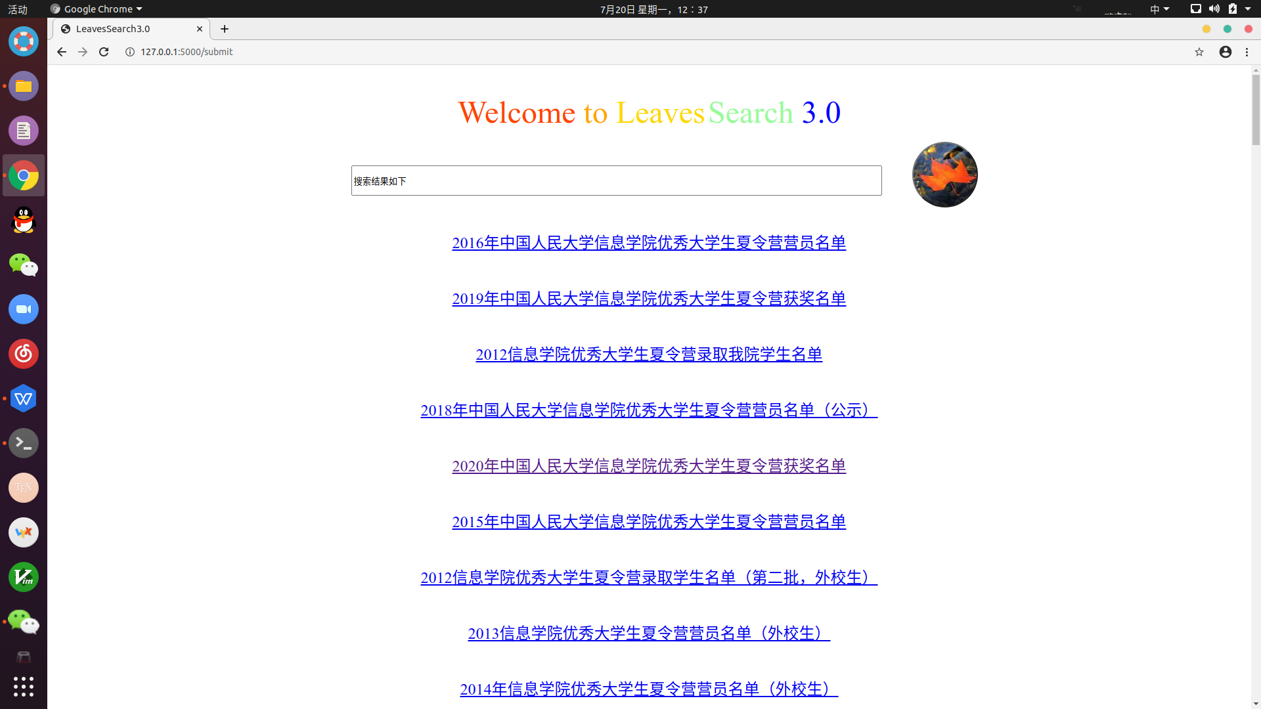
03
Answers for 夏令营名单
文艺让生活更有范，文艺让生活更有范，文艺文艺让生活更有范文艺让生活更有范。文艺让生活更有范，文艺让生活更有范。

Slide 21
04
使用方法及部署方法

Slide 22
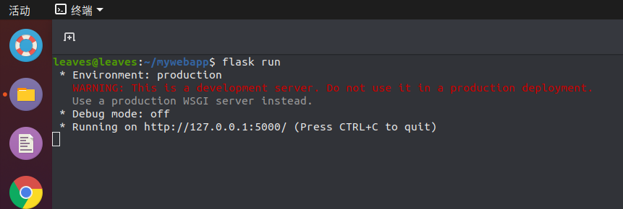
04
使用方法及部署方法
Usage method:
In mywebapp/app,use：
flask run
then go to url http://127.0.0.1:5000/.
And if you want the update program for Url and search data.I can give the way to you.
文艺让生活更有范，文艺让生活更有范，文艺文艺让生活更有范文艺让生活更有范。文艺让生活更有范，文艺让生活更有范。

Slide 23
That’s all.
Thanks.

